Slide 1
THE ROSARY; A STUDY IN CATHOLIC ART
Project 2: Qualitative
Douglas Locke
October 8, 2019

Slide 2
Concept

Slide 3
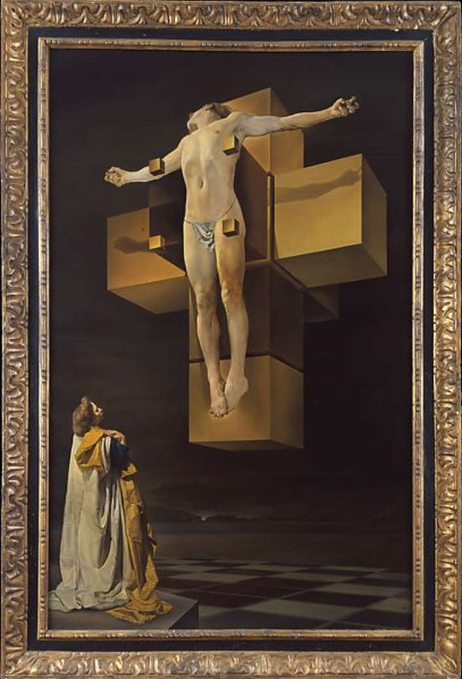
Concept
Goals:
Explore color across as represented across ~135 paintings
Paintings are categorized across the rosary mysteries
Paintings are all from 13th to 20th century art, mostly European.
Questions:
Does color change across different events?
Do nationalities/artists play a role?
Where are colors more muted vs. vibrant?
Means:
Python to extract relevant artwork, plus some manual reduction.
Vibrant.js
“The Crucifixion”
Salvador Dali, 1954

Slide 4
Plan
Data:
Download ~135 paintings by Object Number
Tag each painting with Vibrant.js results like this:
Means:

Slide 5
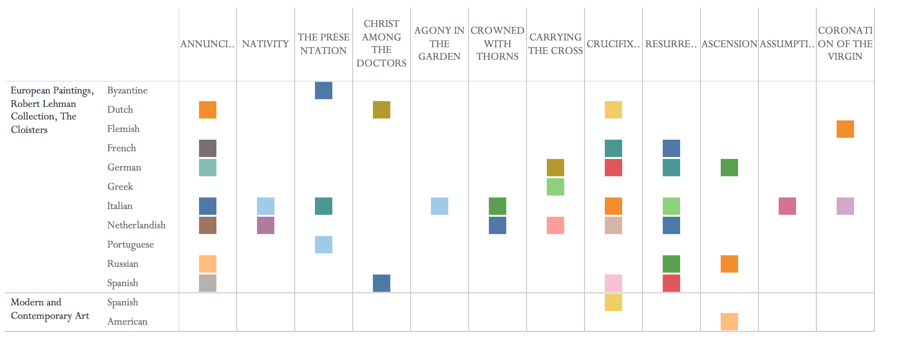
Draft 1
Where multiple paintings exist:
“Round” hue values, find a “mode”, choose the mode (most frequent).
Colors here are placeholders, not actual.

Slide 6
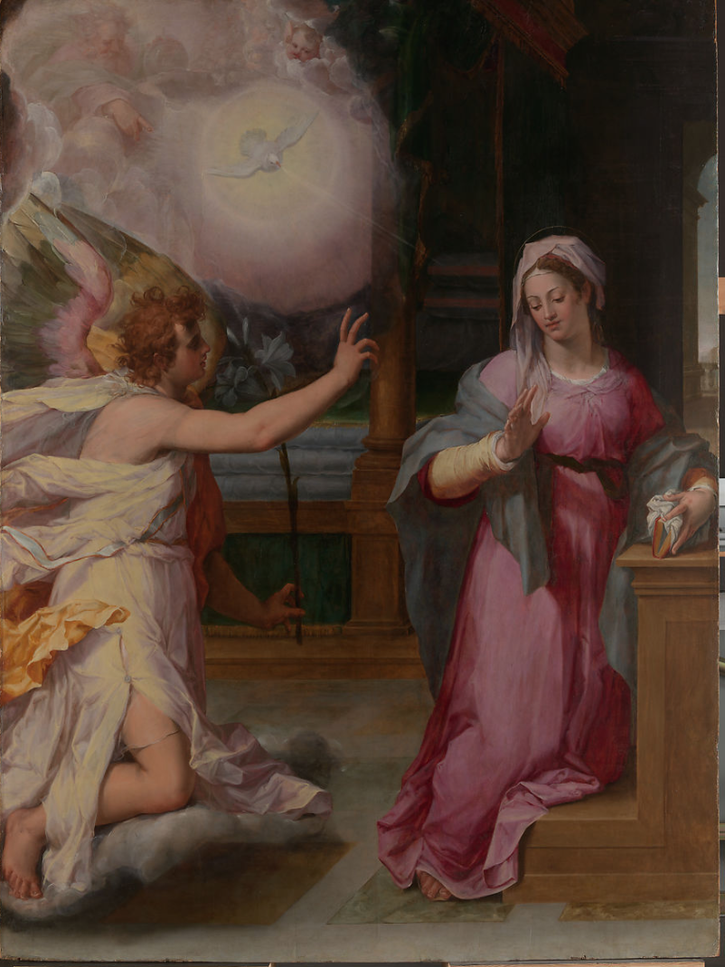
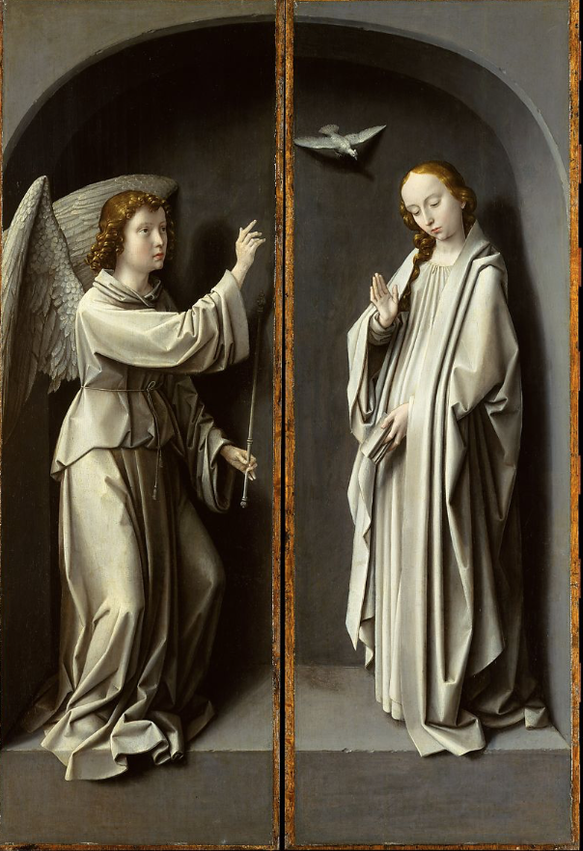
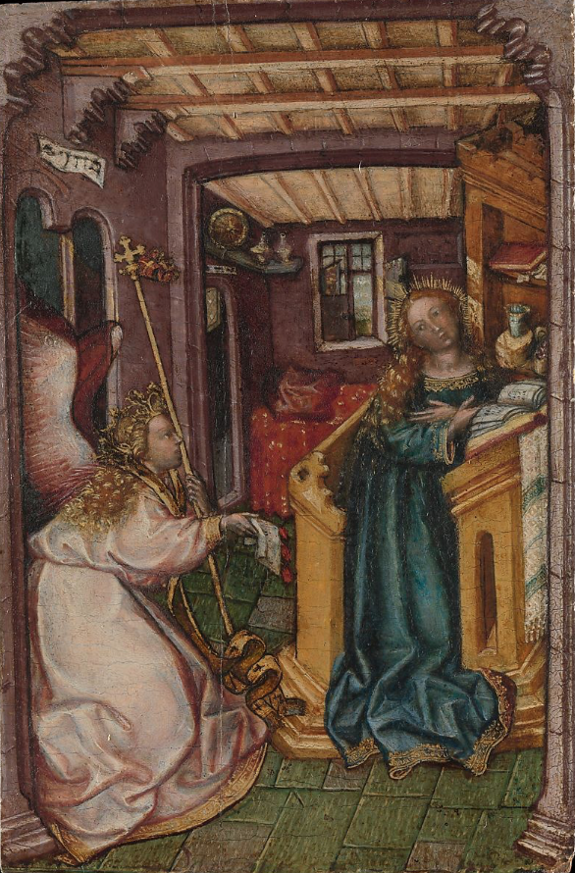
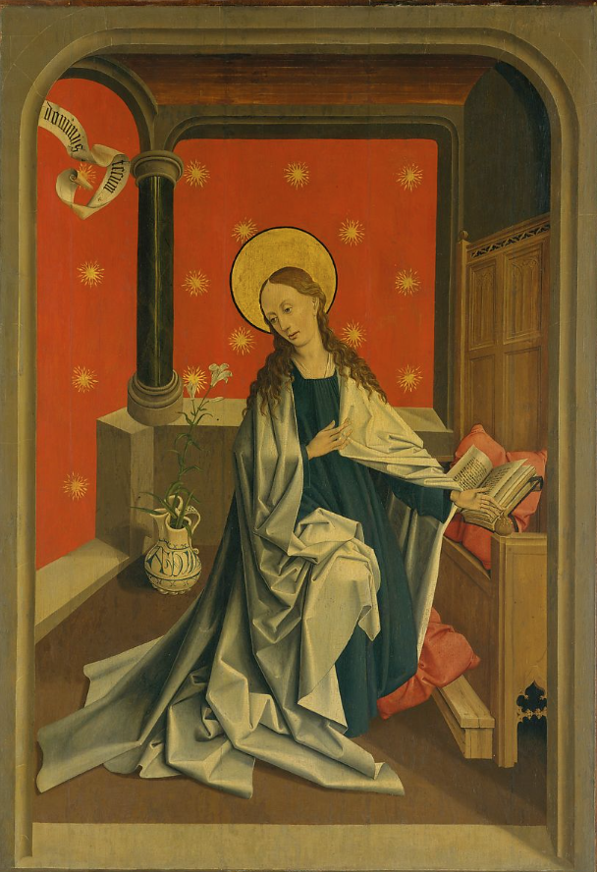
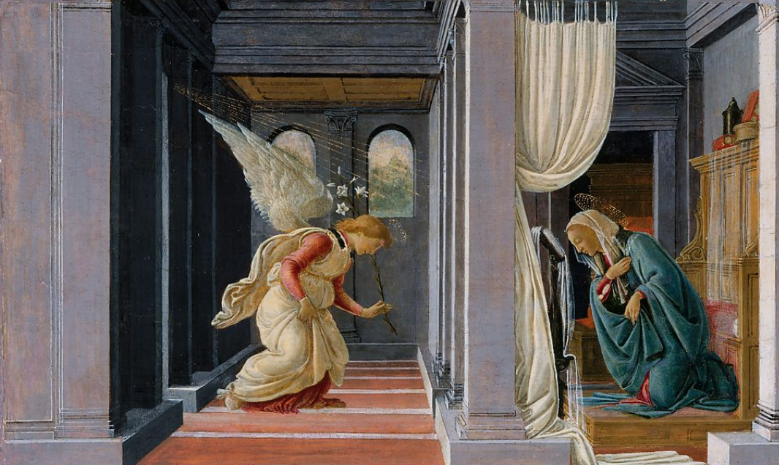
Process 2: Character Focus, The Annunciation
“The Annunciation”
Peter Candid, 1585
“The Virgin Annunciate”
Gerard David, 1510
“The Annunciation”
German Painter, 1440
“The Annunciation”
French Painter, 1450
“The Annunciation”
Botticelli, 1492
Mary
Angel Gabriel

Slide 7
The Annunciation
The Nativity
The Crucifixion
Mary
Angel Gabriel
Joseph
Jesus
John

Slide 8
Typeface
Pffeffer Mediaeval
THE ROSARY; A STUDY IN CATHOLIC ART
Perpetua
THE ROSARY; A STUDY IN CATHOLIC ART

Slide 9
End

